Slide 1
Chapter 16: Acid-Base Equilibria
Dr. Aimée Tomlinson
Chem
1212

Slide 2
Section 16.1
Acids & Bases:
A Brief Overview

Slide 3
Three Theories for Acids & Bases
Arrhenius acids & bases
Brønsted-Lowry acids & bases
Lewis acids & bases

Slide 4
Section 16.2
Brønsted-Lowry
Acids & Bases

Slide 5
Meet Hydronium
H₃O⁺ is acidified water or what truly happens when H⁺ is in H2O
We call this ion hydronium
We use H⁺ and H₃O⁺ interchangeably

Slide 6
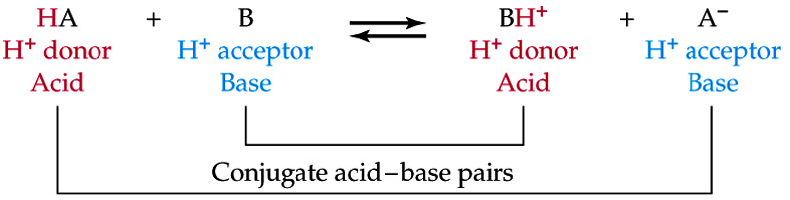
Conjugate Acid-Base Pairs
conjugate acid: the acid that is created after the Brønsted-Lowry base has accepted the proton, BH⁺
conjugate base: the base that is created after the Brønsted-Lowry acid has donated the proton, A⁻
Examples

Slide 7
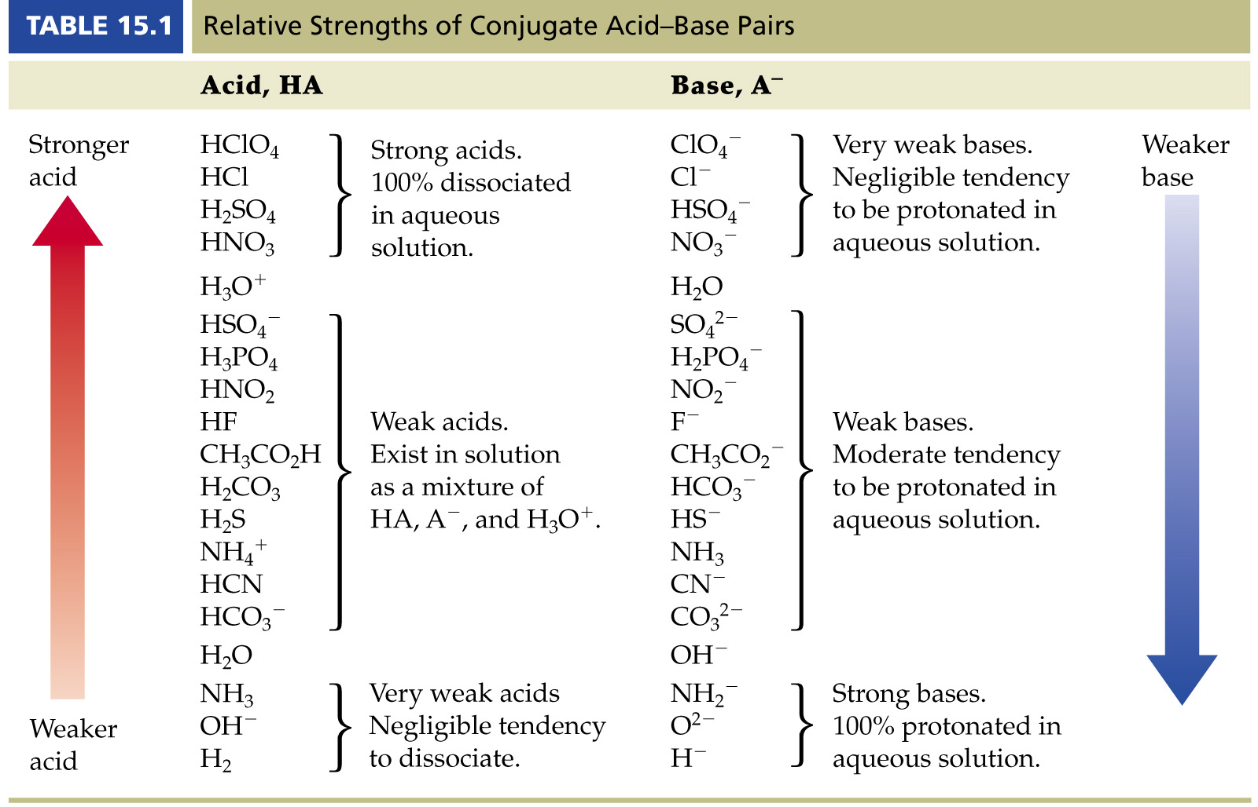
Strong Acids
A strong acid will completely dissociate/ionize:
  All the reactant goes to product/single-headed arrow
  The product is a very weak conjugate acid/base pair
List of Strong acids: HCl, HBr, H₂SO₄, HI, HClO₄, HClO₃, HNO₃

Slide 8
Strong Bases
A strong base will completely dissociate/ionize:
List of Strong bases: MOH (M=alkali metal), NH2-, H-

Slide 9

Weak Acids
Only partially dissociate
The eq constant is called K_{a} where “a” for acid
There is always some reactant still present at eq unlike the strong acid case
The larger the K_{a} the stronger the acid
  E.g. K_{a} >> 1 for HNO₃
  We will come back to this in a little bit
X 5

Slide 10
Section 16.3
Autoionization of Water

Slide 11

Autoionization
Defn: occurs when a species can ionize itself:
$$2H_{2}O_{\left(l\right)}⇌OH_{\left(aq\right)}^{−}+H_{3}O_{\left(aq\right)}^{+}$$

Slide 12
Amphoterism
Defn: A species that may act as both an acid and a base
Water as a base:
Water as an acid:

Slide 13
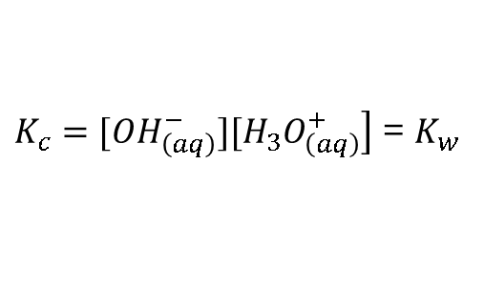

What’s in Water & What it Means
$$2H_{2}O_{\left(l\right)}⇌OH_{\left(aq\right)}^{−}+H_{3}O_{\left(aq\right)}^{+}$$
$\left.K_{c}=[OH_{\left(aq\right)}^{−}][H_{3}O_{\left(aq\right)}^{+}\right]$ = $K_{w}$
NOTE H₂O_{(l)} as always is not in the equilibrium expression
Relationship between [OH⁻_{(aq)}] and [H₃O⁺_{(aq)}]:
For both ions their concentrations at 298 K is 1.0 x 10⁻⁷M making the K_{w} = 1.0 x 10⁻¹⁴

Slide 14
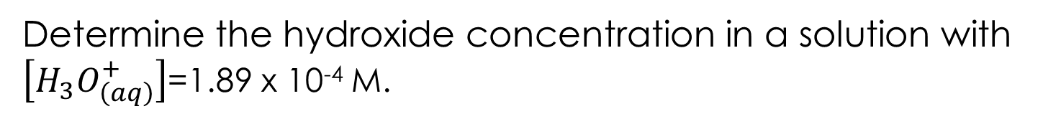
Example
Determine the hydroxide concentration in a solution with $\left[H_{3}O_{\left(aq\right)}^{+}\right]$=1.89 x 10⁻⁴ M.

Slide 15
Section 16.4
The pH Scale

Slide 16
Power of Hydrogen aka pH
pH < 7.0 acidc
pH = 7.0 neutral
pH > 7.0 basic

Slide 17
Power of Hydroxide aka pOH
pOH > 7.0 acidc
pOH = 7.0 neutral
pOH < 7.0 basic

Slide 18
Relationship for pH, pOH & K_{w}

Slide 19
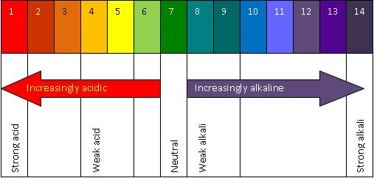
Measuring pH
Litmus paper – color changes based on pH

Slide 20
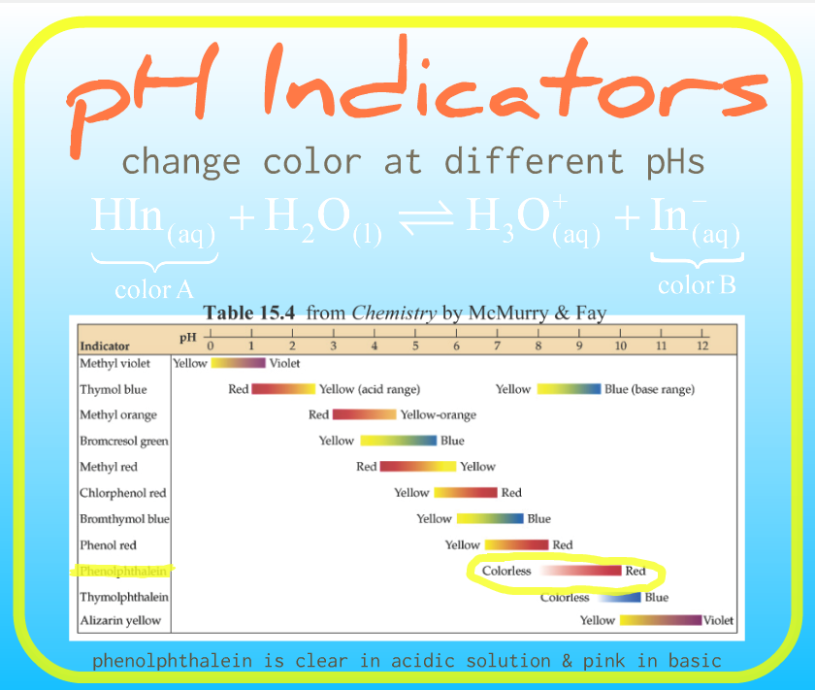
pH Indicators
More relevant in Chapter 15 so we will address it more fully there

Slide 21
Section 16.5
Strong Acids & Bases

Slide 22
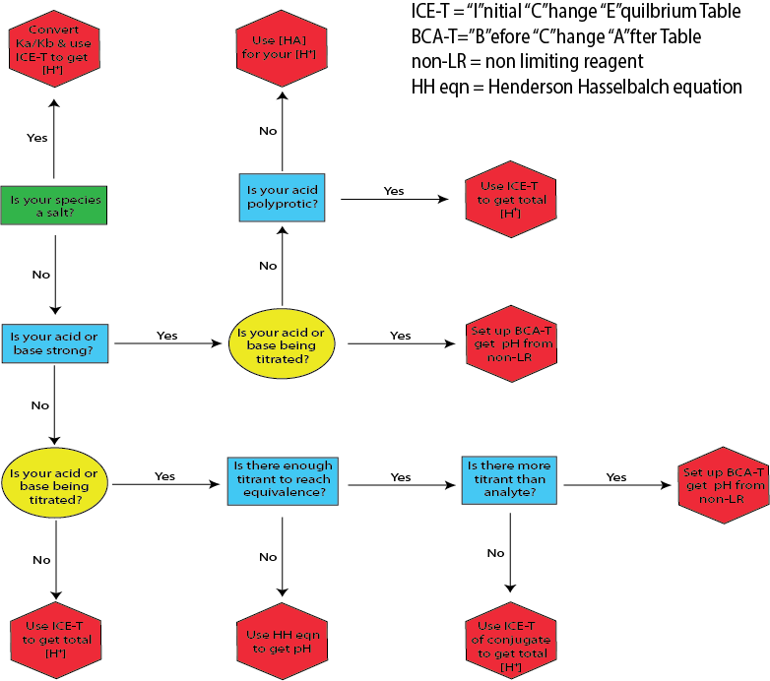
The Strong Completely Dissociate
H₃O⁺/OH⁻ concentrations will become whatever those of the strong acids or bases were

Slide 23
Example I
EXAMPLE: Write the balanced equation for each of the following and determine the pH.
1.) 0.5000 M HClO_{4(aq)}
2.) 0.0256 M LiOH_{(aq)}

Slide 24
Example II
Determine the hydronium ion concentration for a 0.01500 M Ca(OH)₂ assuming complete dissociation.
X 2

Slide 25
Section 16.6
Weak Acids

Slide 26
Weak Acids & Equilibrium
Unlike the strong they only partially dissociate in water hence HA is still present at eq:

Slide 27
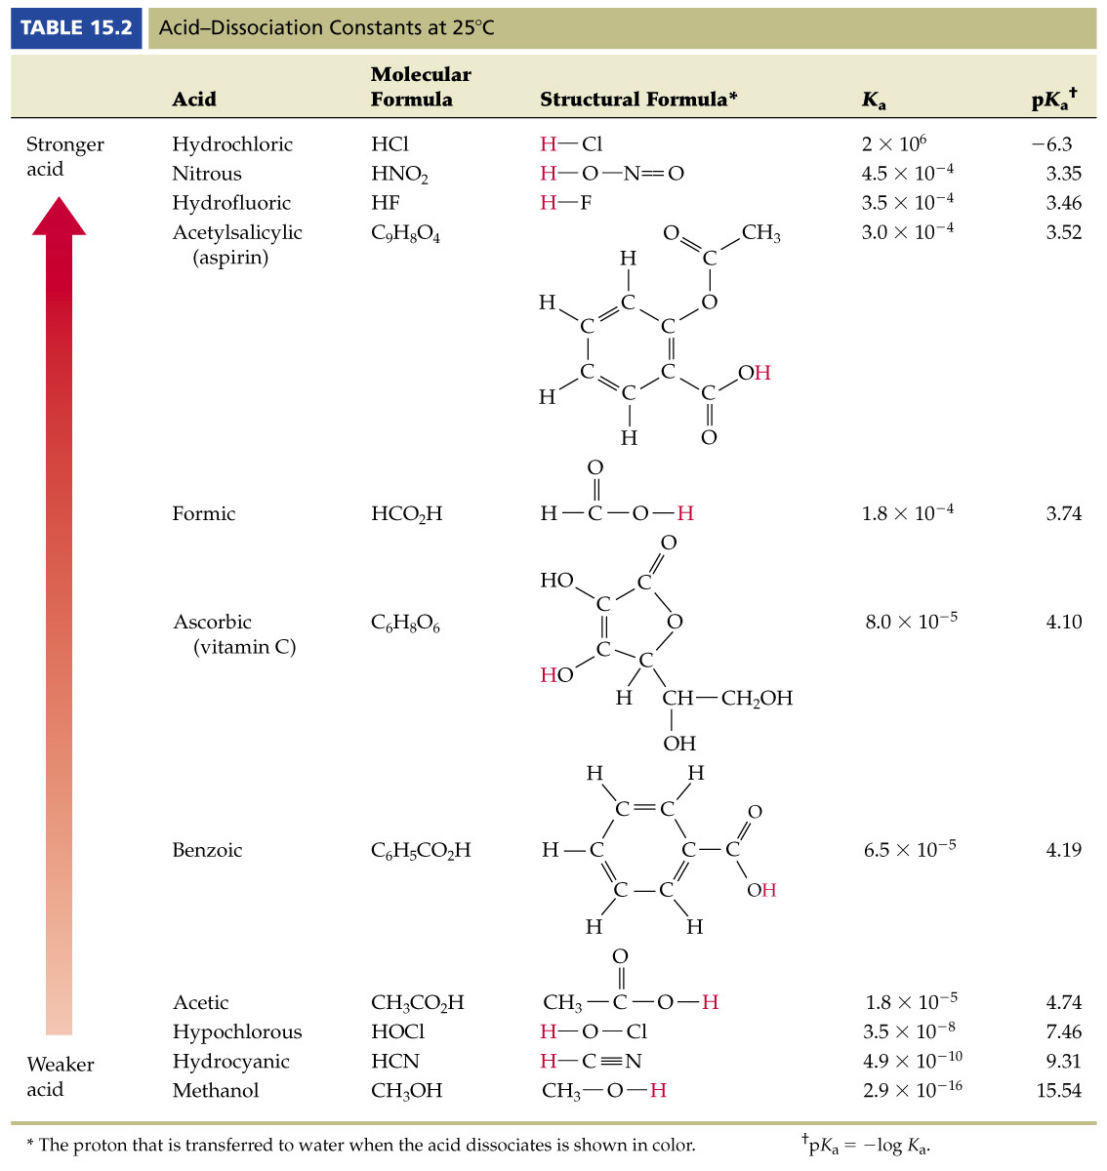
K_{a} & Acid Strength
The larger the K_{a}:
More strongly the eq will lie toward product
More likely the acid is to dissociate
The larger the [H₃O⁺]
The lower the pH
The stronger the acid
K_{a} is large for strong acid HCl but very small for weak acid CH₃OH

Slide 28
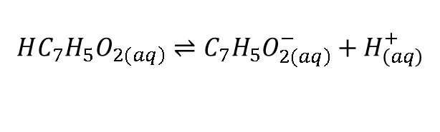
Calculating K_{a} from pH
Similar to our approach using %dissocation from last chapter
Example: What is the K_{a} of a 0.050 M solution of HC₇H₅O₂ if the pH of this solution is 2.75?
$$HC_{7}H_{5}O_{\left.2(aq\right)}⇌C_{7}H_{5}O_{\left.2(aq\right)}^{−}+H_{\left(aq\right)}^{+}$$

Slide 29
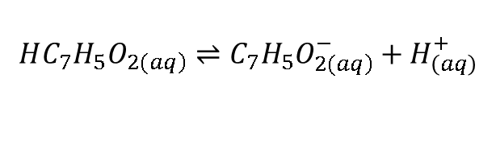
Percent Dissocation
Degree of ionization/dissociation: percentage that an acid ionizes
Example: Determine the percent dissociation of 0.050M of benzoic acid.
$$HC_{7}H_{5}O_{\left.2(aq\right)}⇌C_{7}H_{5}O_{\left.2(aq\right)}^{−}+H_{\left(aq\right)}^{+}$$

Slide 30
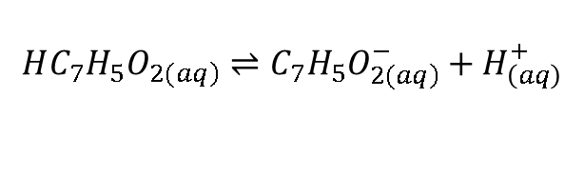
Weak Acids & Equilibrium
Calculate [H⁺] and the pOH of 0.050M of benzoic acid. Ka = 6.5 x 10⁻⁵
$$HC_{7}H_{5}O_{\left.2(aq\right)}⇌C_{7}H_{5}O_{\left.2(aq\right)}^{−}+H_{\left(aq\right)}^{+}$$

Slide 31
Weak Acid Flowchart

Slide 32
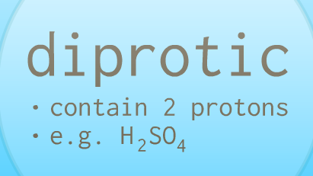
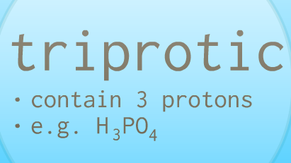
Polyprotic Acids
Acids which possess more than one proton

Slide 33
Polyprotic Acid Example
Calculate the [H⁺] of 0.050M of sulfuric acid.

Slide 34
Polyprotic Acid Flowchart

Slide 35
Why K_{a1} > K_{a2}
Electrostatically it is more difficult to remove H⁺ from SO₄²⁻ than from HSO₄⁻
Hence K_{a2} is always smaller than K_{a1} and so on

Slide 36
Section 16.7
Weak Bases

Slide 37
Weak Base Equilibria
Calculate pH of 0.050M of ammonia. Kb = 1.8 x 10⁻⁵

Slide 38
Weak Base Flowchart

Slide 39
Section 16.8
The Relationship Between K_{a} & K_{b}

Slide 40
The Link Between K_{a} & K_{b} is K_{w}

Slide 41
Example
Determine the K_{b} of HCN if K_{a} = 4.9 x 10⁻¹⁰.

Slide 42
Section 16.9
Acid-Base Properties of Salt Solutions

Slide 43
Stronger Partner Dominates
Strong acid + weak base = acidic solution
Weak acid + strong base = basic solution
Strong acid + strong base = neutral solution
Example: Classify each of the following as acidic, basic, or neutral.
1.) KBr 2.) NaNO₂ 3.) NH₄Cl

Slide 44
What if both are weak?
Example II: Classify NH4CN as acidic, basic, or neutral.

Slide 45
Finding pH/pOH of a Salt Solution
Calculate the pH of a 0.25M NaC₂H₃O₂, K_{a} = 1.76x10⁻⁵

Slide 46
Salt Flowchart

Slide 47
Section 16.10
Acid-Base Behavior & Chemical Structure

Slide 48
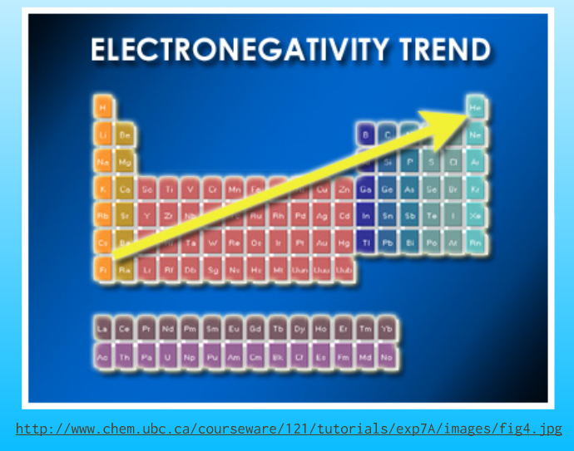
Recall Electronegativity Trend

Slide 49
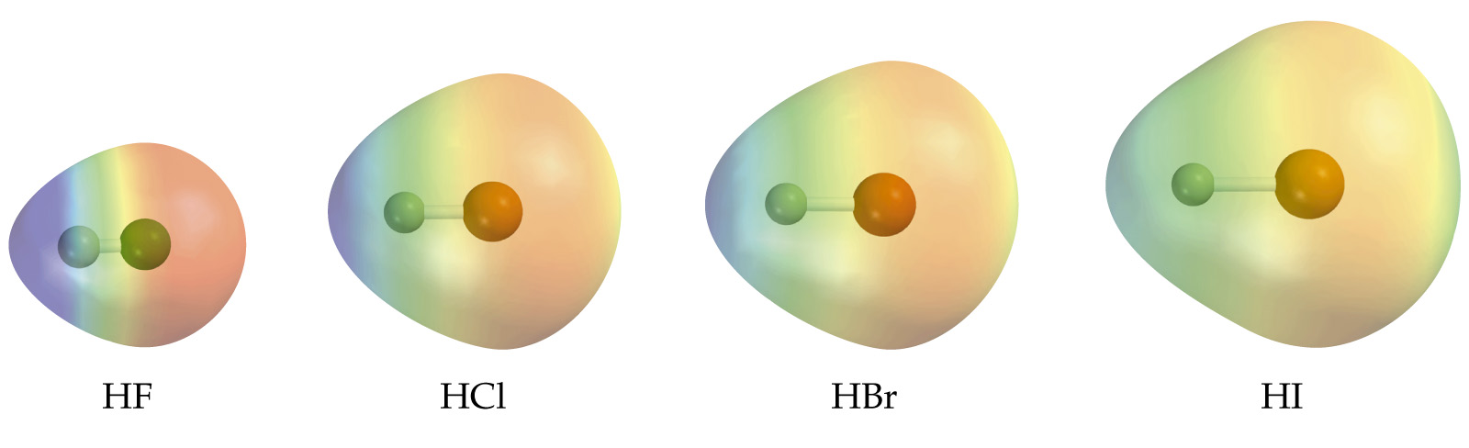
EN Trend I
Increasing acid strength going down the table:
As we go down a column we decrease EN
We thereby weaken the H-X bond
Allows H+ to more readily go into solution
Acid strength: HF < HCl < HBr < HI

Slide 50
EN Trend II
Increasing acid strength from left to right in the table:
As we go across we increase EN
We make the H-X bond polar
This eventually gives an EN difference which leads to H+
Acid strength: CH₄ < NH₃ < H₂O < HF

Slide 51
Oxoacids Trend I – more EN
An oxoacid is any acid with acidic proton connected to an O-atom – they have the form H_{n}XO_{m}
As increase the EN of the halogen X we weaken the O-H bond
This is done by pulling electron density from the O-atom
This will allow the H+ to break-away more eqsily and go into solution
Acid strength: HOI < HOBr < HOCl < HOF

Slide 52
Oxoacids Trend II
Increasing the number of O-atoms increases acid strength
As increase the number of O-atoms weakens the O-H bond
Again this is done by pulling electron density from the O-atom
This will allow the H+ to break-away more easily and go into solution
Acid strength: HOCl < HO₂Cl < HO₃Cl < HO₄Cl
Acid | Oxidiation State of Cl | K_{a}
HClO | +1 | 2.9 x 10⁻⁸
HClO₂ | +3 | 1.1 x 10⁻²
HClO₃ | +5 | ≈1
HClO₄ | +7 | 1 x 10⁸

Slide 53
Amine Base Trends
Increasing the number of electron-donating groups will increase base strength
Increasing the number of electron-withdrawing/EN groups will decrease base strength

Slide 54
Section 16.11
Lewis Acids and Bases

Slide 55
Definitions
Lewis Acid
Electron-pair acceptor
Lewis Base
Electron-pair donor
X 2

